Slide 1
PUBLIC INFORMATION CENTER
Township of Clearview
Nottawasaga 26/27 Sideroad
May 8, 2019

Slide 2
The Project

Slide 3
Existing Road

Slide 4
Study Area

Slide 5
Environmental Impact Study
For the purpose of the EIS, the Study Area includes:
The Impact Area includes 5.40 ha of area.
the existing roadway occupies 1.36 ha within the IA.
proposed improvements to the road include 1.21 ha of encroachment into natural features and other land uses to the south, and 1.16 ha to the north.
resulting in an overall impact of 2.37 ha of lands that required for construction activities.

Slide 7
The EIS addresses:
The policies of the Provincial Policy Statement;
The policies and development criteria of the Niagara Escarpment Plan;
The policies of the County of Simcoe and the Township of Clearview Official Plans; and,
The requirements of the Nottawasaga Valley and Grey Sauble Conservation Authorities
The policies of the Niagara Escarpment Planning Area and features designated under this plan (Niagara Escarpment Commission, 2017)

Slide 8
Key Natural Heritage Features Investigated as part of the EIS Included:
Significant and Non-evaluated wetlands
Habitat of endangered and threatened species
Fish habitat
Areas of Natural and Scientific Interest (ANSI)
Significant valleylands
Significant woodlands
Significant wildlife habitat
Habitat of special concern species
Permanent or intermittent Streams and Lakes
Seepage areas / springs

Slide 9
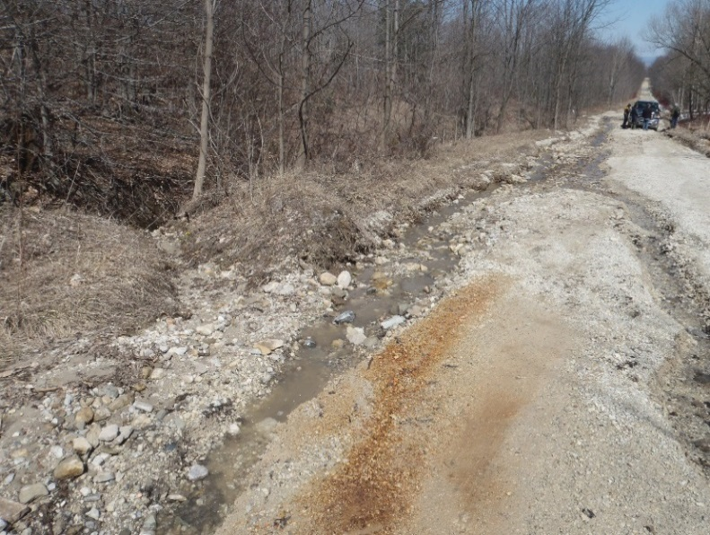
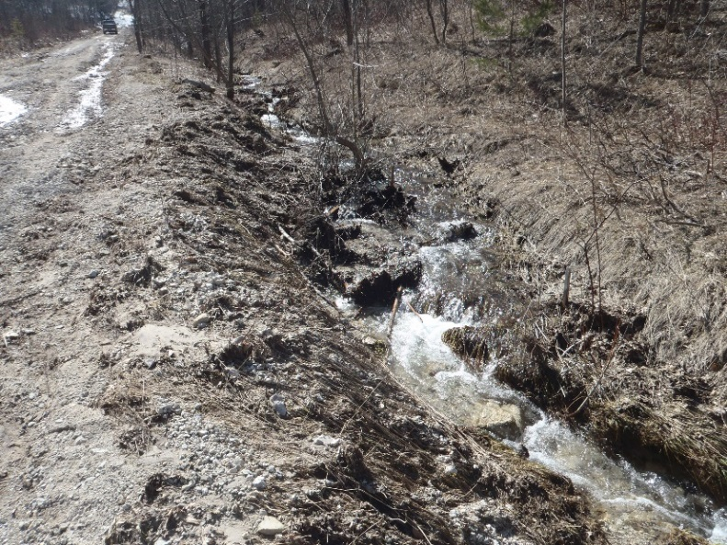
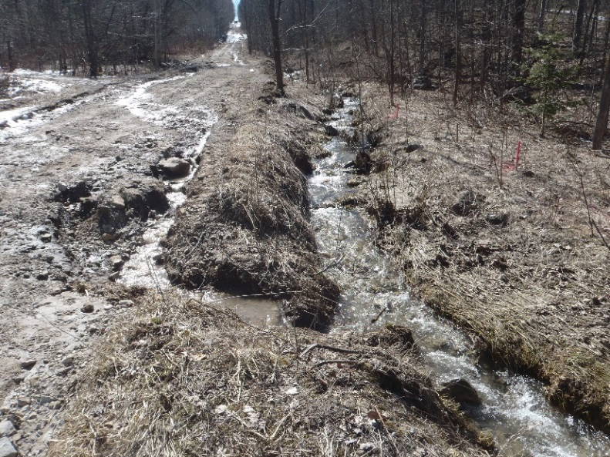
Erosion Impacts

Slide 10
Existing Aquatic Conditions
Coldwater stream that supports Brook Trout
High gradient with bedrock ledges from Escarpment
Impassable barriers to upstream movement for fish
Considerable impacts to fish habitat from surface run-off and erosion
Not considered highly productive for reproduction based on spawning surveys

Slide 11
Aquatic and Amphibian Monitoring Stations

Slide 12
Water Level and Temperature Monitoring Stations

Slide 13
DFO Approval Process
Proposed realignment of 19m to improve habitat conditions and Road Improvements
Project has been submitted to DFO for Review
Approval under a Letter of Advice has been received by DFO for Clearview Township

Slide 14
DFO Approved Realignment

Slide 15
Stormwater Management Strategy
Incorporates two main types of low impact development (LID) practices to achieve enhanced quality control
A bioretention LID concept adapted to a rural road cross-section
The use of enhanced grassed swales
Both methods receive good reviews for achieving quality control and water balance benefits

Slide 16
Bioretention
Performance results from both laboratory and field studies indicate that bioretention systems have the potential to be one of the most effective BMPs for pollutant removal
Bioretention provides effective removal for many pollutants as a result of sedimentation, filtering, soil adsorption, microbial processes and plant uptake

Slide 17
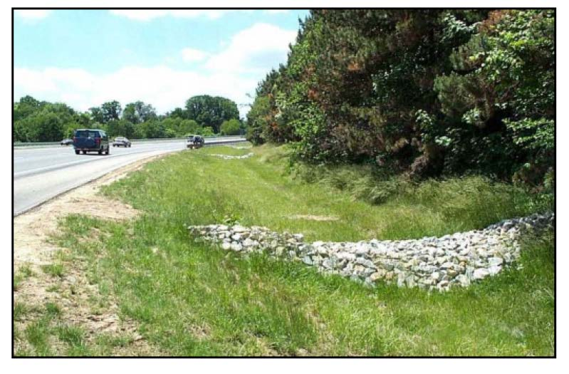
Enhanced Grassed Swales
Slow down stormwater through the vegetated swale such that quiescent settling of particles can occur
Swales remove pollutants
76% of total suspended solids,
55% of total phosphorus,
50% of total nitrogen

Slide 18
Stormwater Management Design
Incorporates bio-retention and enhanced grassed swales
Narrow footprint to minimize the development area
Addresses existing failing ditches, erosion, pollutants from traffic, poorly aligned watercourse crossings, fish barriers, flooding
Provides enhanced level quality control of stormwater
Satisfies the quantity control and emergency access criteria
Conveys the 5 year storm in ditches and driveway culverts
Conveys the 100 year event through road crossing culverts

Slide 19
Stormwater Management Design
Provides improved fish passage by un-perching culverts, providing a larger flow area, natural river stone embedment and a low flow channel
Preserves groundwater inputs to fisheries
Provides a series of stepped rock check dams to improve oxygenation of water and dissipate energy
Includes recommendations for construction
The most practical solution to protect the natural environment

Slide 20
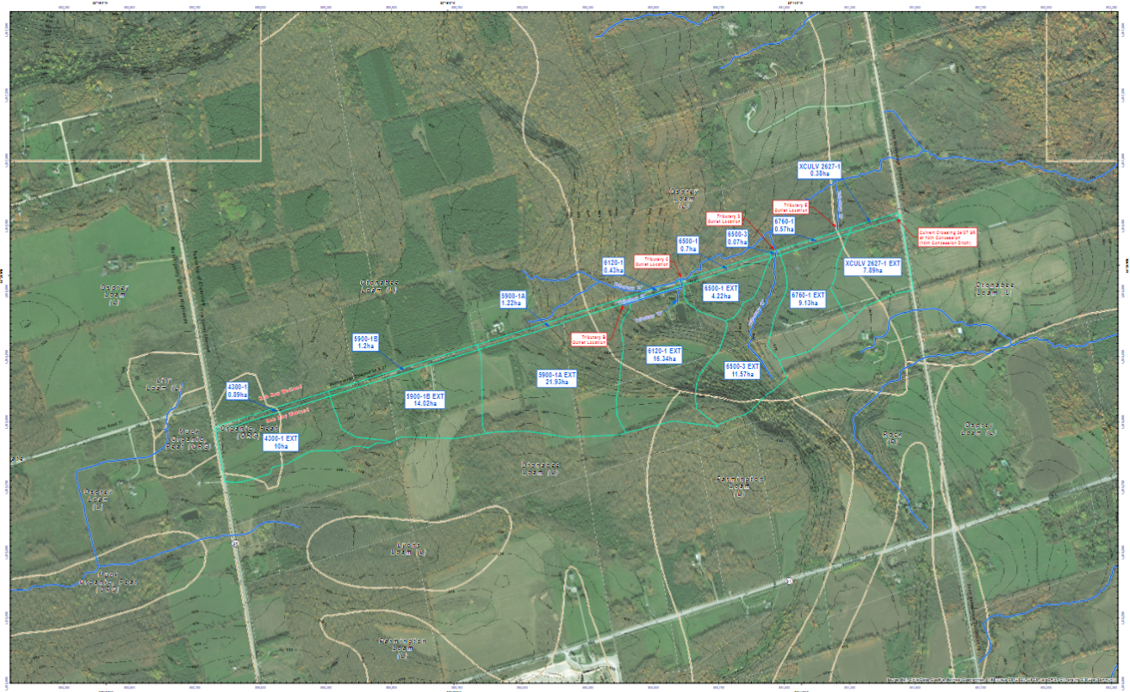
Existing Catchments

Slide 21
Bioretention and Perforated Pipe, Stormwater Management Concept

